Slide 1

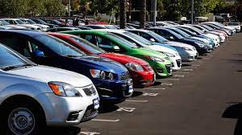
EXPLORATORY DATA ANALYSIS
PROJECT ON
USED CARS MARKET ANALYSIS

Slide 2
About us :
I am Sravan Tunikipati completed Graduation (B-Tech) from VIJAYA ENGINEERING COLLEGE in the stream Electrical and Electronics Engineering.
I am Chiranjeevi Malleboina completed Graduation (B.Sc) from SRI GOUTHAMI DEGREE AND PG COLLEGE.
We are passionate in learning Data Science because learning Data Science enables us to extract valuable insights from vast amounts of data, and solve complex problems across various domains, ultimately driving innovation and efficiency in a data-driven world.

Slide 3
PROBLEM STATEMENT
BUSINESS PROBLEM:
The used cars market is dynamic and influenced by various factors such as year of manufacturing, kilometers driven, fuel type, consumer preferences, and technological advancements. Our aim is to gain valuable insights in the used cars market to optimize according to the customer preferences. The primary focus is on understanding the key factors that impact the pricing of used cars.
USE CASE DOMAIN :
The focus of this exploratory data analysis (EDA) project is to analyze and derive meaningful patterns and trends from a dataset comprising key features of used cars. The dataset includes information on price, kilometers driven, year of manufacturing, fuel type, gear type, and brand. By gaining a deeper understanding of these features, we aim to provide actionable insights.

Slide 4
OBJECTIVE OF THE PROJECT :
Identify Trends: Explore how each feature correlates with the price and whether any observable trends exist.
Outlier Detection: Identify and understand outliers in the dataset, as they may provide valuable insights into specific market segments.
Feature Importance: Assess the impact of each feature on pricing to understand their relative importance in the used cars market.
4.Consumer Preferences: Analyze patterns to understand consumer preferences, such as the influence of fuel type, gear type, and brand on purchasing decisions.

Slide 5

WEB SCRAPING DETAILS :
We have extracted this information from the website “www.cars24.com”.
The CARS24 platform facilitates the transaction and has an offline presence. Apart from selling used cars, the company's services include paperwork such as transferring the car to the name of the new owner which enables end-to-end transactions and offers an online auction platform to businesses looking to sell their pre-owned cars.
In 2019, the company started offering verified used cars where the company offered a buyback guarantee on the vehicles verified by inspection.

Slide 6





TOOLS USED FOR OUR PROJECT :

Slide 7
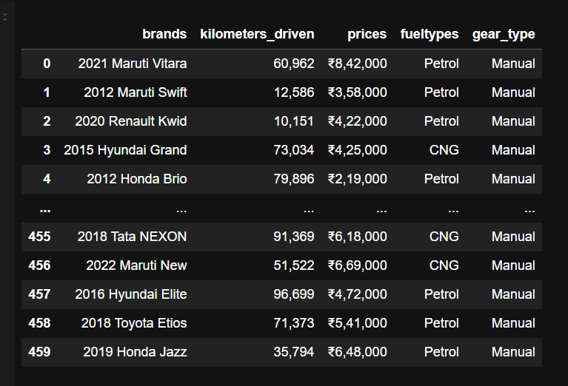
RAW DATA:

Slide 8
DATA CLEANING:
There are no Nan values and duplicates in our collected data.
We removed commas in numerical columns and converted the datatype to integer.
We got a column with ‘manufacturing year’, ‘Brand’, ‘Model’.
We split the column into three separate columns.
Our dataset is ready to convert into csv file.

Slide 9
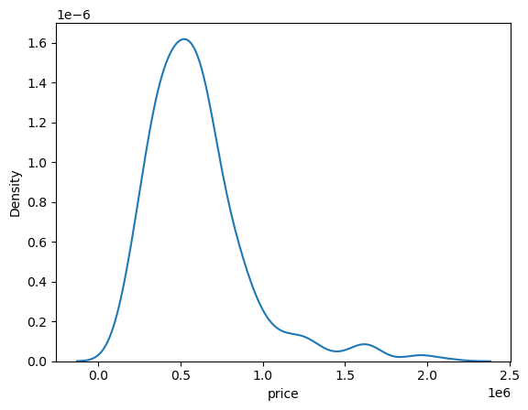
Density of Price
Most of the cars have price range of 5,00,000.

Slide 10
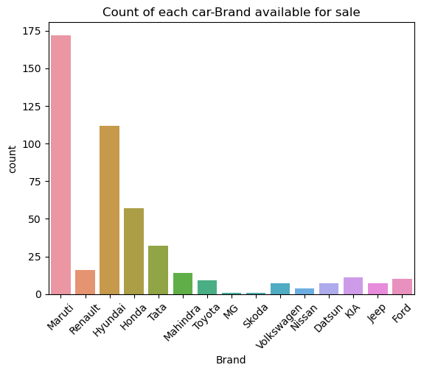
This count plot says that Maruthi has highest number of cars for sale where as MG and Scoda have lowest number

Slide 11
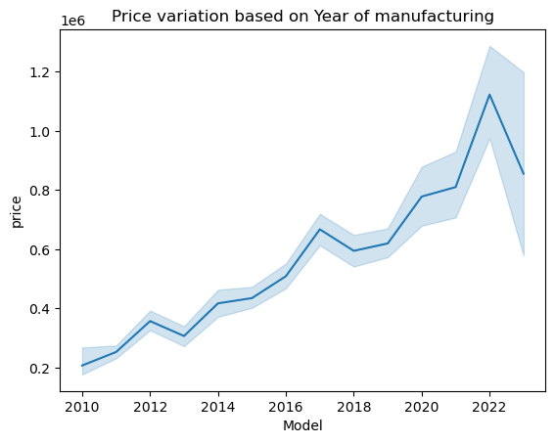
BI-VARIATE ANALYSIS :

Slide 12
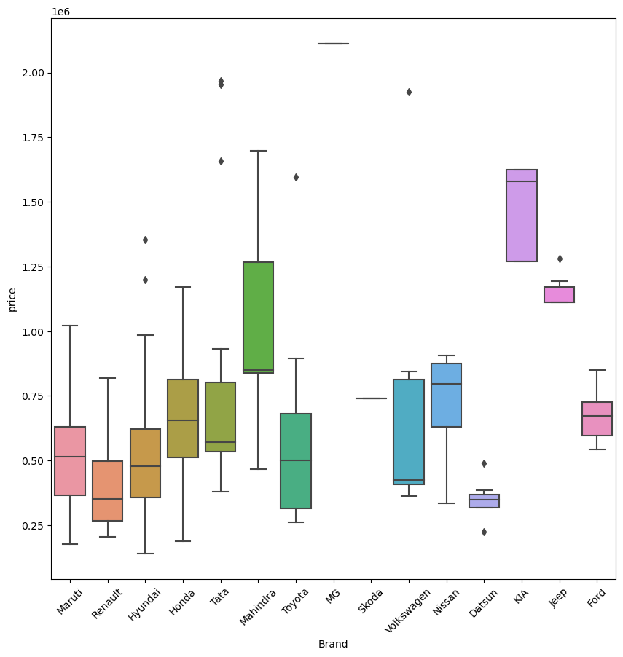

Slide 13
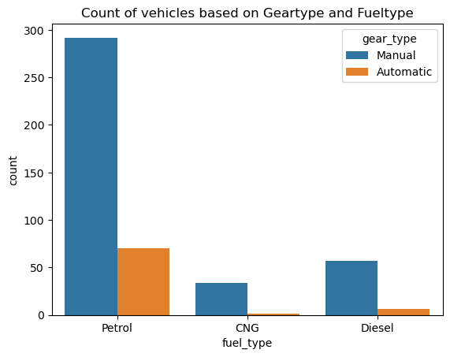

Slide 14
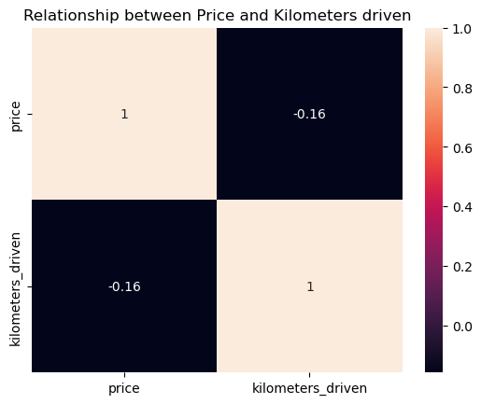
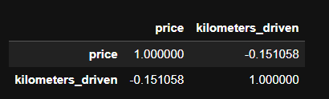

Slide 15
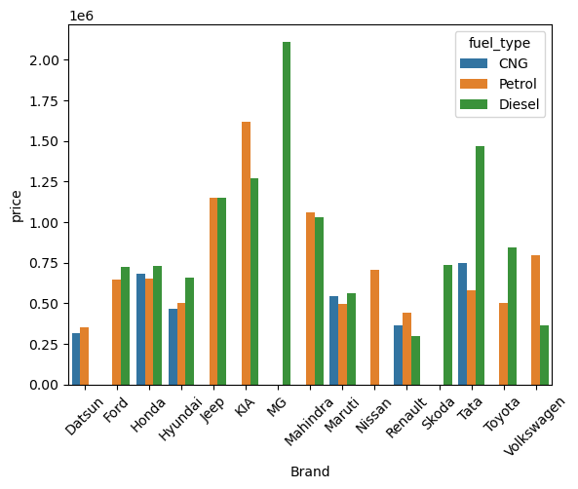
MULTIVARIATE ANALYSIS:

Slide 16
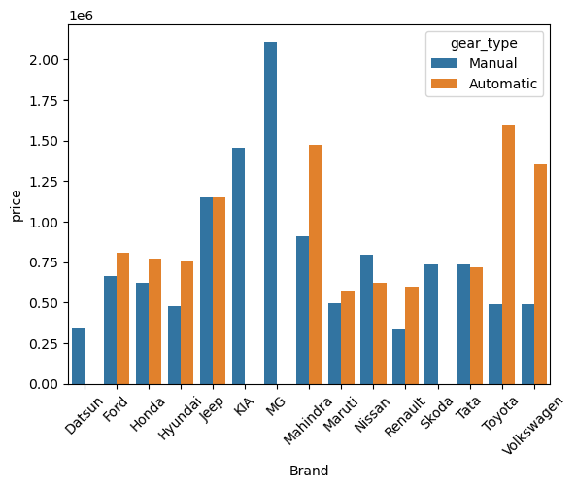

Slide 17
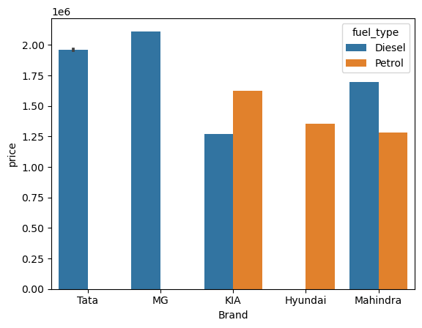
BRAND AND PRICE VARIATION BASED ON PRICE RANGE 12,00,000 TO MAXIMUM.

Slide 18
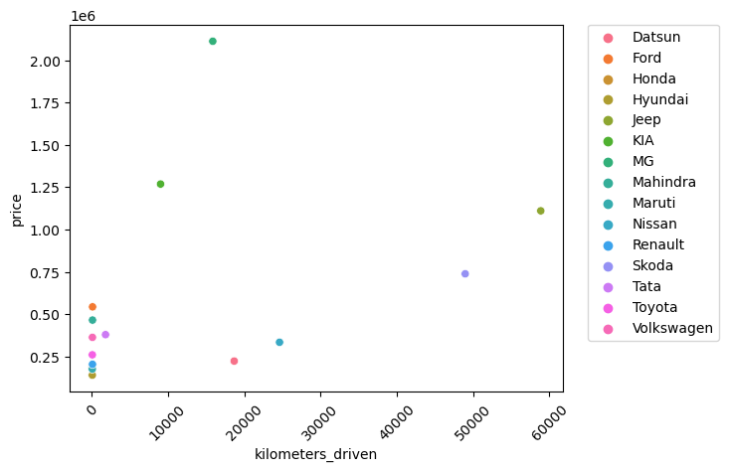

Slide 19
CONCLUSION:
By the above analysis we can conclude that MG car has highest price among all because it is added recently for sale.
Most number of cars fuel type is petrol but compared to diesel cars these cars have low price.
Compared to all brands Maruthi brand is having the high availability.
Even though Maruthi having the high availability of cars Renault brand cars are having low price.
Customers can afford car prices below 7,50,000. Because the range above this price are travelled more and have high price and are not affordable by commoners.
Customers who are interested in buying costly brands can afford price range above 7,50,000.

Slide 20

THANK YOU

